Slide 1

TrashCan - Application to segregate Recyclable Waste using Deep Learning
SRM INSTITUTE OF SCIENCE AND TECHNOLOGY
SCHOOL OF COMPUTING
DEPARTMENT OF COMPUTING TECHNOLOGIES
18CSP107L - MINOR PROJECT
Supervisor name: Dr. S. Babu
Designation: Associate Professor Department: Department Of Computing Technologies
Batch ID: B139
Student 1 Reg. No: RA1911003010090
Student 1 Name: Naman Jain
Student 2 Reg. No: RA1911003010108
Student 2 Name: Suvodeep Saibal Sinha

Slide 2
Project Abstract
In 2021, India currently ranks 155 out of 180 countries in the environmental performance index. This is due to poor handling of waste management and pollution. With the emergence of several government schemes such as “Swachh Bharat Abhiyan” and “Smart Cities Mission”, there has been a surge in both garbage production and its collection. But, there is zero effort to segregate the waste.
A major part of segregation is still dependent on manual labor which is slow and inefficient. Hence, we propose an automated way to segregate waste into recyclable and non-recyclable components using Deep Learning(Convolutional Neural Networks) embedded into a Mobile Application.

Slide 3
Literature Review
A literature review is a piece of academic writing demonstrating knowledge and understanding of the academic literature on a specific topic placed in context.
We have looked through approximately 10 research papers with topics or concepts related to our project. Focusing on different aspects of these papers was useful to help plan, develop, refine and write a comparative analysis of the whole corpus

Slide 4
Comparison of Existing Methods
Title | Approach and Algorithm | Accuracy | Notable Achievements | Remarks
A Method for Waste Segregation using CNN | Comparison between VGG 16, ResNet, AlexNet | 94.9 % (ResNet-50) | 25,077 images were used in the dataset Compilation of various techniques over the years | Segregation based on only 2 categories - Organic and Recyclable
Trash Classification Using CNN - Stanford University | CNN with last 2 layers replaced by a classifier (softmax or SVM) | 79.94 % (AlexNet with SVM as last layer) | Clear and simple implementation of only 2 methods Less computation power required | Categories are limited to 6 Sample size of dataset is only 2527

Slide 5
Title | Approach and Algorithm | Accuracy | Notable Achievements | Remarks
A deep learning approach based hardware solution to categorise garbage in environment | InceptionNet Neural Network Architecture using a Real-time embedded system | 96.2 % (Inception Net) | Implemented hardware solution consisting of Raspberry Pi, IR sensor and PI Camera | Only 6 classes are used to categorise garbage
Waste Segregation Using Deep Learning | Zero Shot Learning and Object Detection Algorithms | 83.60 % (YOLOv3) | Unique approach to task Algorithm mentioned clearly with plans of proposed system | Focus on Object Detection rather than classification Trained on COCO Dataset

Slide 6
Title | Approach and Algorithm | Accuracy | Notable Achievements | Remarks
Xception: Deep Learning with Depth Wise Separable Convolutions | Improvement on InceptionNet | —------ | Xception significantly outperforms Inception V3 on a larger image classification dataset comprising 350 million images and 17,000 classes. | The performance gains are not due to increased capacity but rather to a more efficient use of model parameters.
Intelligent Waste Classification System Using Deep Learning CNN | CNN(Alexnet) with last 2 layers replaced by a classifier | 85 % (AlexNet with SVM as last layer) | Takes care of overfitting with dropout layer | Limited to only 4 different categories Small dataset of 1989 images

Slide 7
Title | Approach and Algorithm | Accuracy | Notable Achievements | Remarks
Classification of Trash for Recyclability Status - Stanford University | SVM with SIFT features CNN with Torch7 framework | 63 % (SVM) | Use of a simpler algorithm as SVM Implemented an eleven layer CNN that is very similar to AlexNet | Small dataset of 2527 images DIfferentiated on the basis of 6 classes
Classification of TrashNet Dataset Based on Deep Learning Models | Inception Resnet V2, Xception architectures | 94 % (Inception Resnet V2) | Adam and Adadelta were used as the optimizer in neural network models | Limited samples of the Trashnet dataset

Slide 8
Problem Statement
Garbage Recycling is a key aspect of preserving our environment. To make the recycling process possible/easier, the garbage must be sorted into groups that have similar recycling processes.
We found that most available datasets classify garbage into a few classes (2 to 6 classes at most).
Being able to classify the images into more classes is a big step towards improving the recycling process by increasing the percentage of recycled garbage.

Slide 9
Objectives
Segregation and management of waste have been a longstanding issue that has impacted a vast percentage of the ecosystem. It is easier to manage waste using today’s technology if they are applied properly.
We found that most available datasets classify garbage into a few classes (2 to 6 classes at most). Despite that, among all the previously explored options, the highest accuracy achieved was 79.94% with CNN and (SVM as last layer) using partial data augmentation. However, no matter what techniques which were added on, it was extremely hard to break through the 80% threshold with the scratch model.

Slide 10
Proposed Methodology
We propose an automated way to segregate waste into recyclable and non-recyclable components using Deep Learning (CNN) embedded into a Mobile Application. We use image classification techniques on a dataset of 15000+ images consisting of different types of waste. The system will be tested on real images taken by the user within the intended usage environment through our mobile application. After processing the images, the application will correctly classify the waste as recyclable or not for the benefit of the user.
We plan to achieve this by using a diverse dataset and software tools like Tensorflow, Python, Flask, Android Studio, and Flutter.

Slide 11
Architecture Diagram

Slide 12
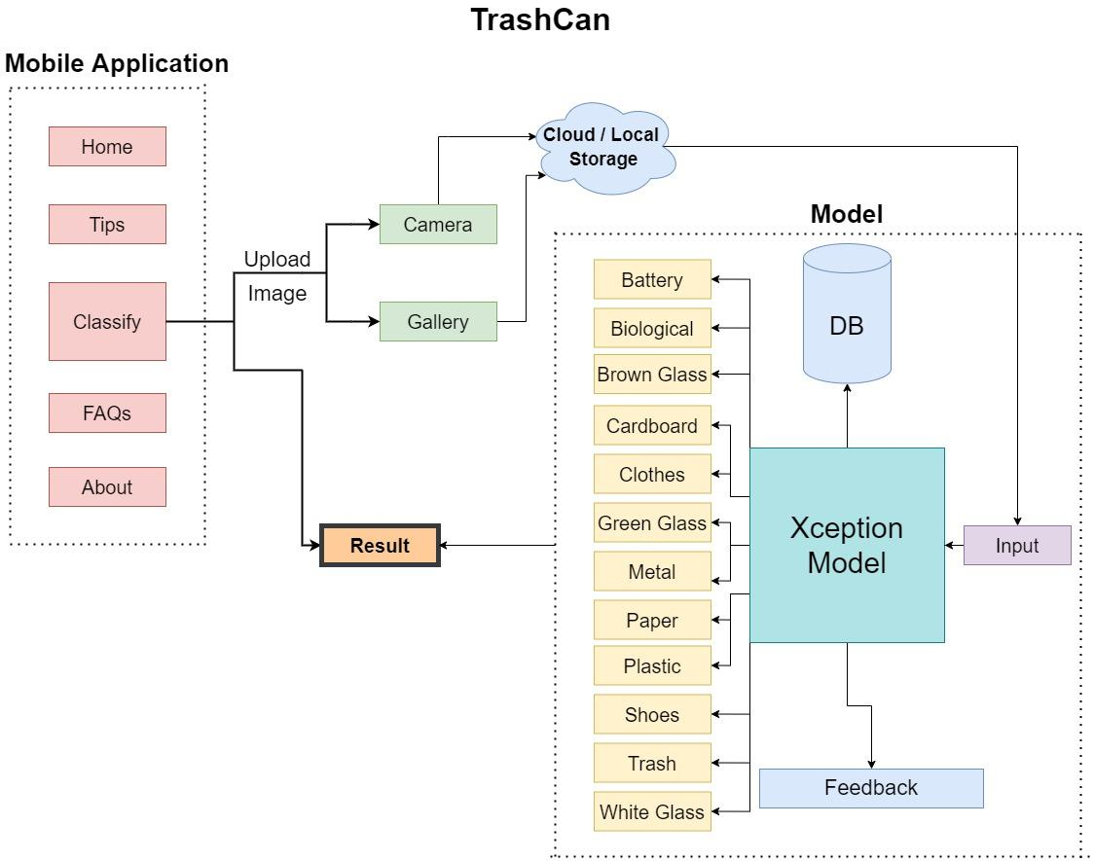

Slide 13
Flow Diagram

Slide 14
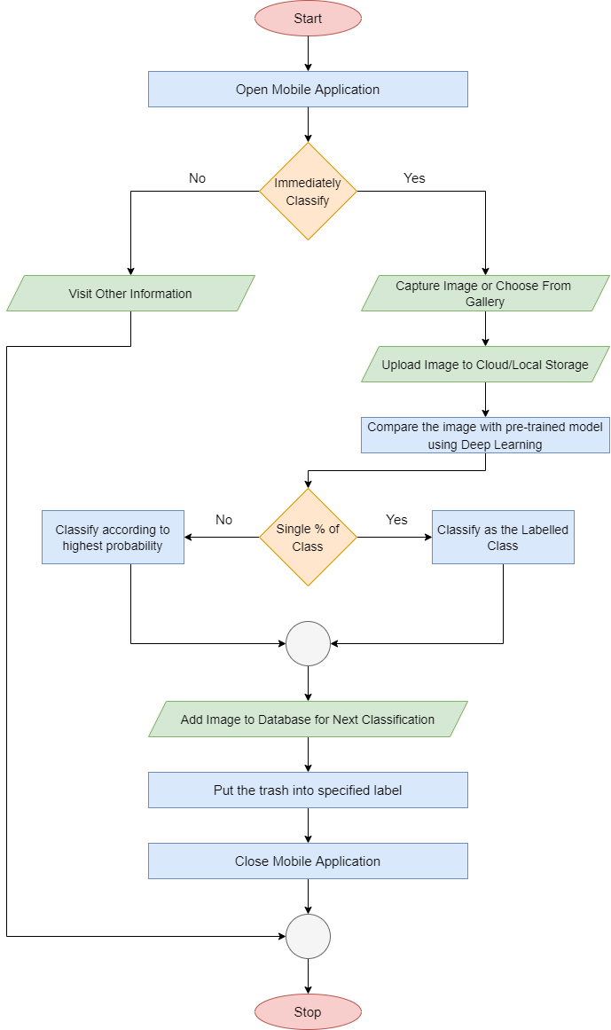

Slide 15
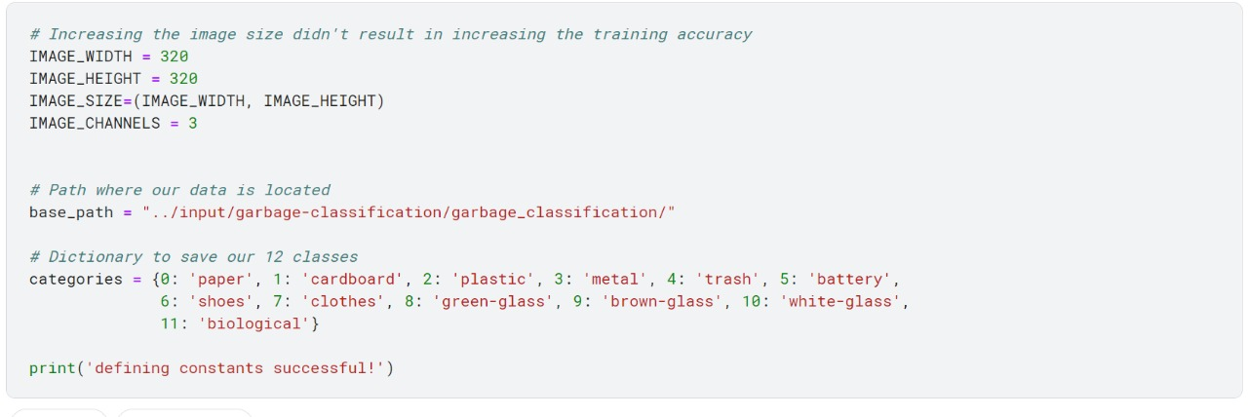
Module Description and Implementation
Defining Categories and Parameters

Slide 16
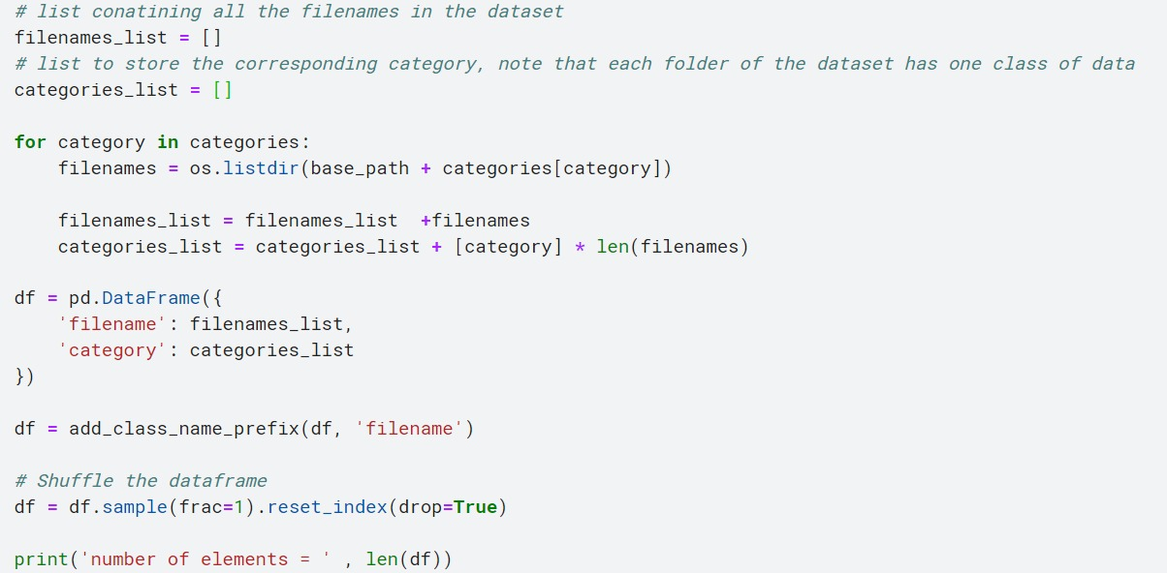
Cleaning Data

Slide 17
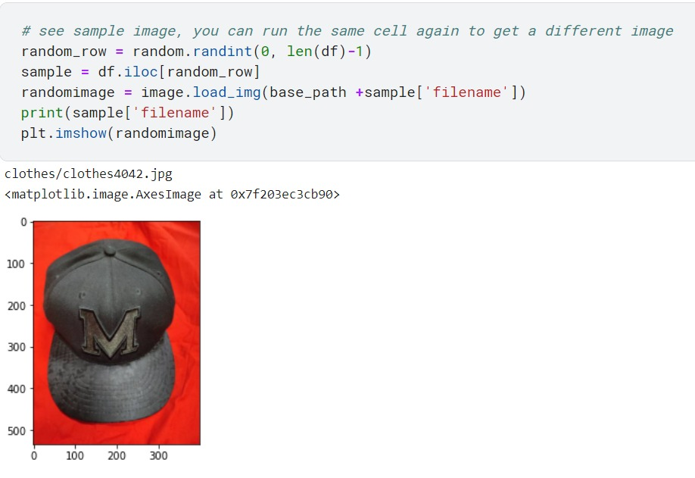
Visualizing Data

Slide 18
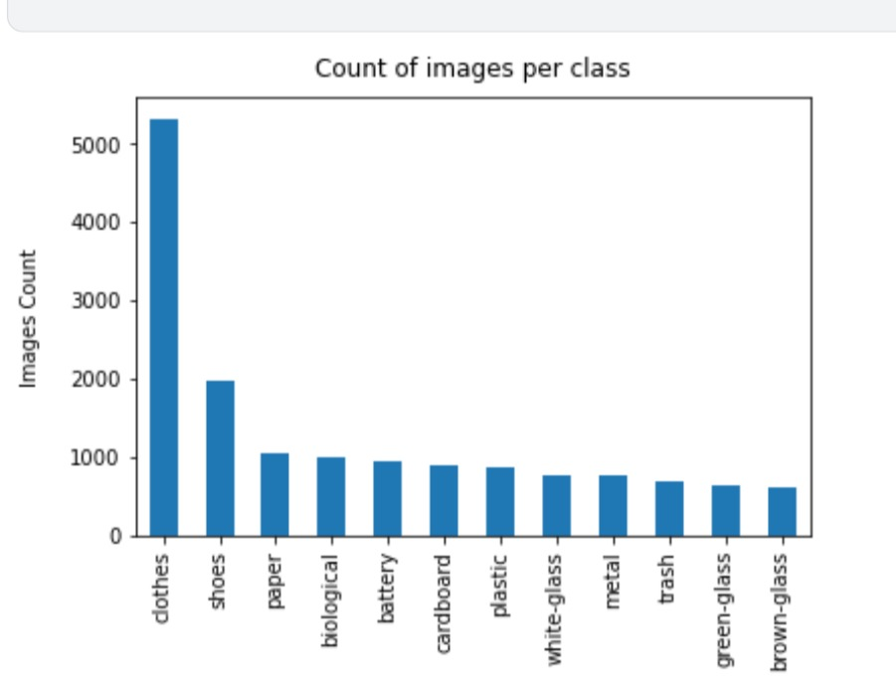
Intermediate Results
and Discussion
Category Distribution

Slide 19
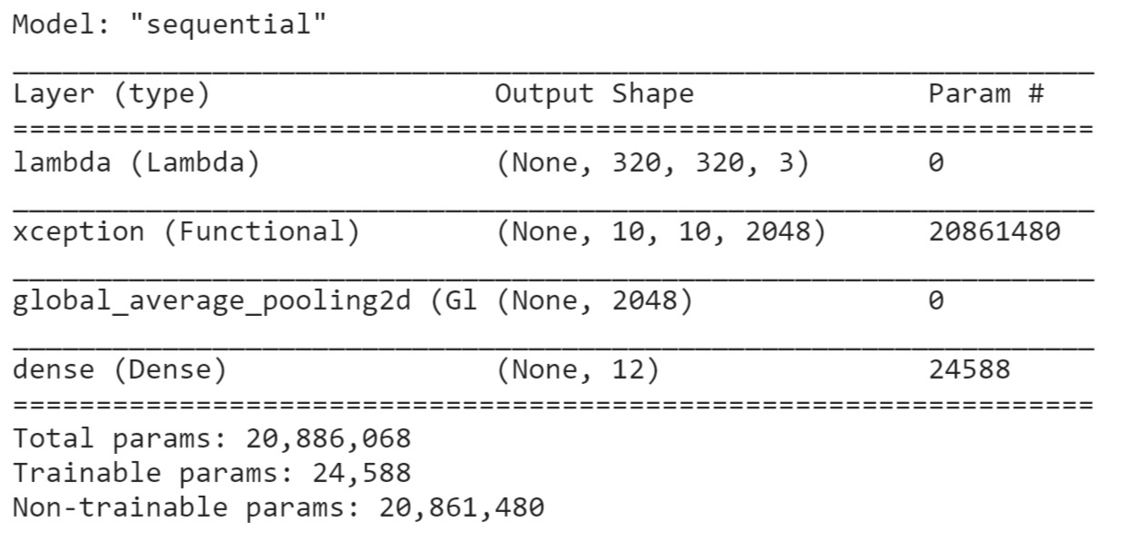
Model Structure

Slide 20
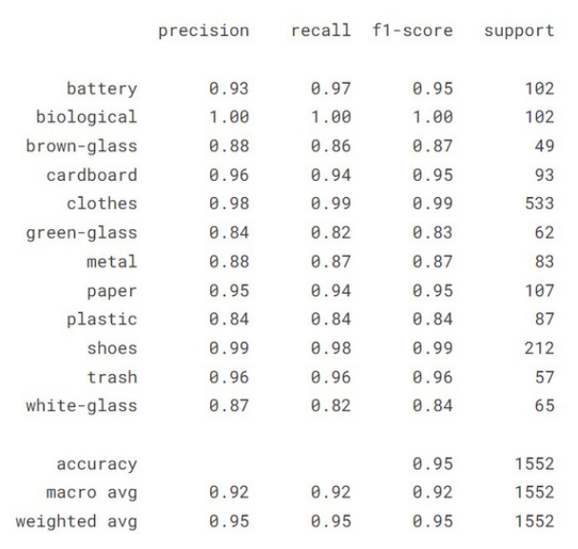
Accuracy Analysis

Slide 21
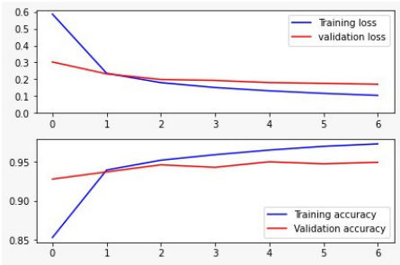
Accuracy Representation

Slide 22
Screenshots

Slide 23
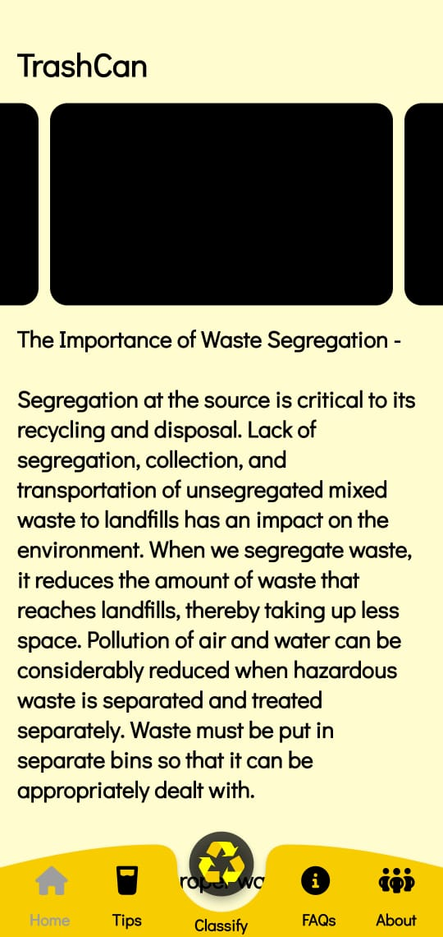
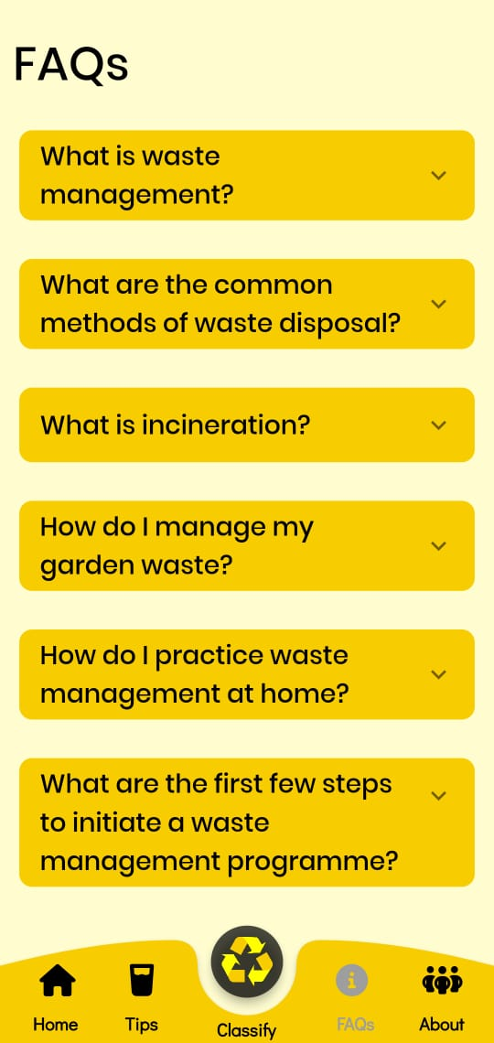

Slide 24
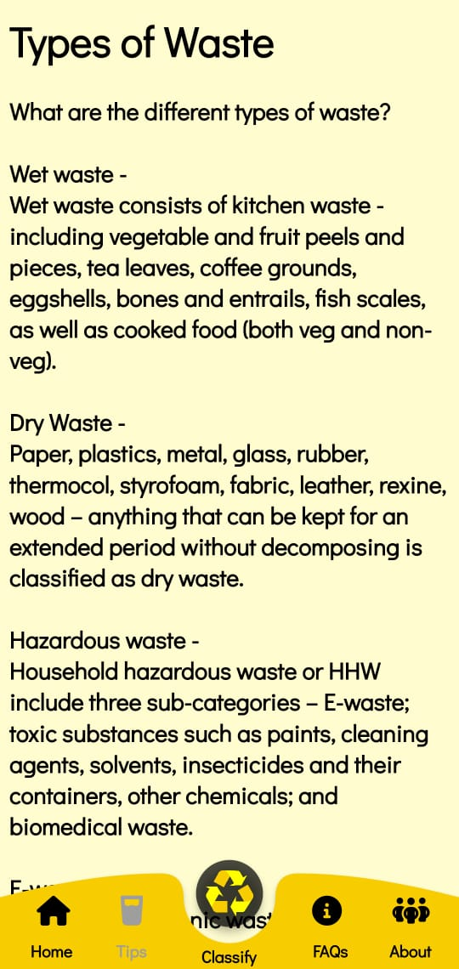
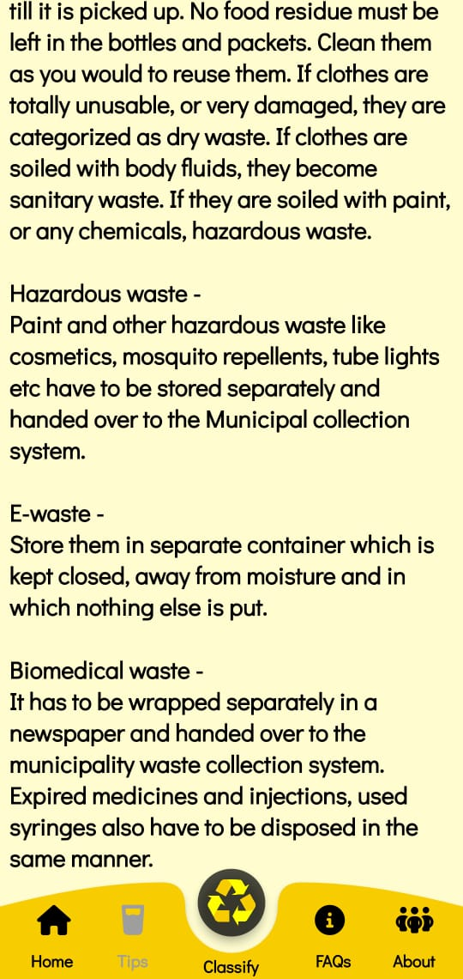

Slide 25
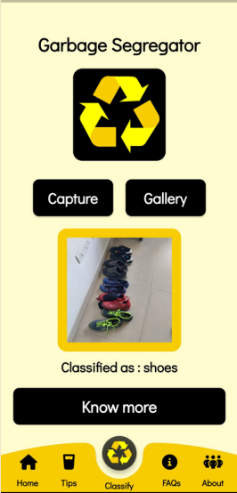
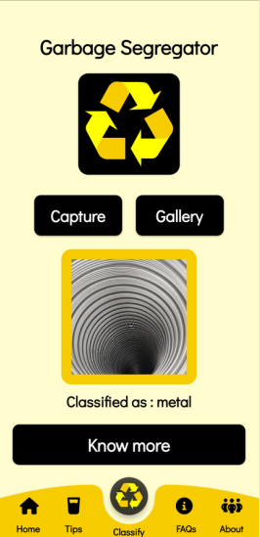

Slide 26
References
F. Chollet. Keras. https://github.com/fchollet/keras, 2015. [3] D.-A. Clevert, T. Unterthiner, and S. Hochreiter. Fast and accurate deep network learning by exponential linear units (elus). arXiv preprint arXiv:1511.07289, 2015.
https://link.springer.com/content/pdf/10.1007/s40747-021-00529-0.pdf
. Chu Y, Huang C, Xie X, Tan B, Kamal S, Xiong X (2018) Multilayer hybrid deep-learning method for waste classification and recycling. Comput Intell Neurosci
Github | “Trashnet waste repository”. https://github.com/ garythung/trashnet.
Sekar S. Waste classification data. Kaggle, 16 June 2019, www. kaggle.com/techsash/waste-classification-data.
Serezhkin A. Drinking waste classification. Kaggle, 10 May, 2020, www.kaggle.com/arkadiyhacks/drinking-waste-classification

Slide 27
ANY QUESTIONS

Slide 28
THANK YOU

